Slide 1
Deep Generative Modeling for Volume Reconstruction in Cryo-Electron Microscopy
Szu-Chi Chung
Department of Applied Mathematics, National Sun Yat-sen University

Slide 2
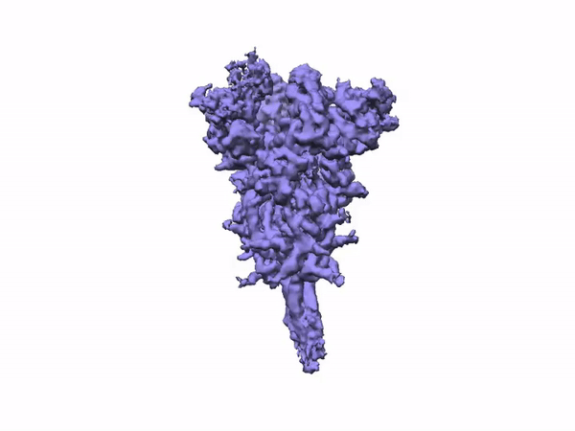
0. From snapshot to dynamic movie - Cryo-EM in structural biology
Insight for biological function
Determine 3D structure and dynamic movies of protein
Recently, computational methods combining with cryo-EM have also been studied in various works [1]
A general and efficient method that can analyze conformations
Provide information for developing vaccines/drug [2,3]
https://cryosparc.com/blog/2019-nCoV
Notes:
https://cryosparc.com/blog/2019-ncov
3D Variability Analysis in cryoSPARC v2 resolves flexible conformational change of the S-protein
A founding principle of structural biology is that, once researchers can directly observe macromolecules in enough detail, it should be possible to understand how their 3D structures confer their biological functions. Indeed, many scientific advances have relied on directly observing the world around us in as much detail as possible, and efforts are increasingly being dedicated to visualizing the atomic structures of biological components that have a key role in human disease.
Nmr hard to solve large protein
https://deepmind.com/research/case-studies/alphafold
Inside every cell in your body, billions of tiny molecular machines are hard at work. They’re what allow your eyes to detect light, your neurons to fire, and the ‘instructions’ in your DNA to be read, which make you the unique person you are.
Currently, there are around 200 million known proteins, with another 30 million found every year. Each one has a unique 3D shape that determines how it works and what it does.
But figuring out the exact structure of a protein remains an expensive and often time-consuming process, meaning we only know the exact 3D structure of a tiny fraction of the proteins known to science.
Finding a way to close this rapidly expanding gap and predict the structure of millions of unknown proteins could not only help us tackle disease and more quickly find new medicines but perhaps also unlock the mysteries of how life itself works.

Slide 3
0. Generative modeling
Recent next-generation volume reconstruction algorithms that combine generative modeling with end-to-end deep unsupervised learning techniques have shown promising results on simulated data [4]
Deep Unsupervised Learning - to learn representations without labels [5]
Notes:
but still face considerable hurdles when applied to experimental cryo-EM images
physicists, structural biologists, computer scientists, statisticians, and applied mathematicians
Deep Unsupervised Learning - to learn representations without labels
Self-Supervised Learning - Create your own supervision through pretext tasks

Slide 4
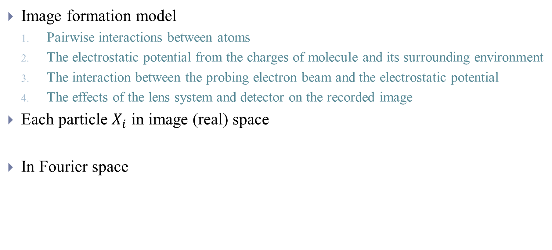
0. Image formation model
Image formation model
Pairwise interactions between atoms
The electrostatic potential from the charges of molecule and its surrounding environment
The interaction between the probing electron beam and the electrostatic potential
The effects of the lens system and detector on the recorded image
Each particle $X_{i}$ in image (real) space
In Fourier space
Notes:
Ri is a 3D rotation representing the 3D orientation of the volume V(i) with respect to the direction of the electron beam.
The oriented volume is subsequently “pierced through” by the electron beam and projected onto the detector—an operation represented in Equation (1) by the 2D-projection operator P2D.
The variable ti represents the 2D translation of the projected volume with respect to the centre of the image.
The effect of the microscope’s lens system is modeled through the convolution of the 2D projection by an image-dependent operator PSFi called the Point Spread Function (PSF) of the microscope whose parameters such as the defocus can be image dependent.
Finally, additional noise is introduced in the observed image, as represented by the variable ei, which is typically assumed to be centered with variance s2 i .
In Fourier Space, the convolution of the projected 2D volume by the PSF conveniently becomes an elementwise matrix multiplication
the operator P(Ri;ti)i first extracts out of ˜V (i) a slice oriented by the rotation Ri and then applies a phase shift in Fourier space accounting for the 2D translation

Slide 5
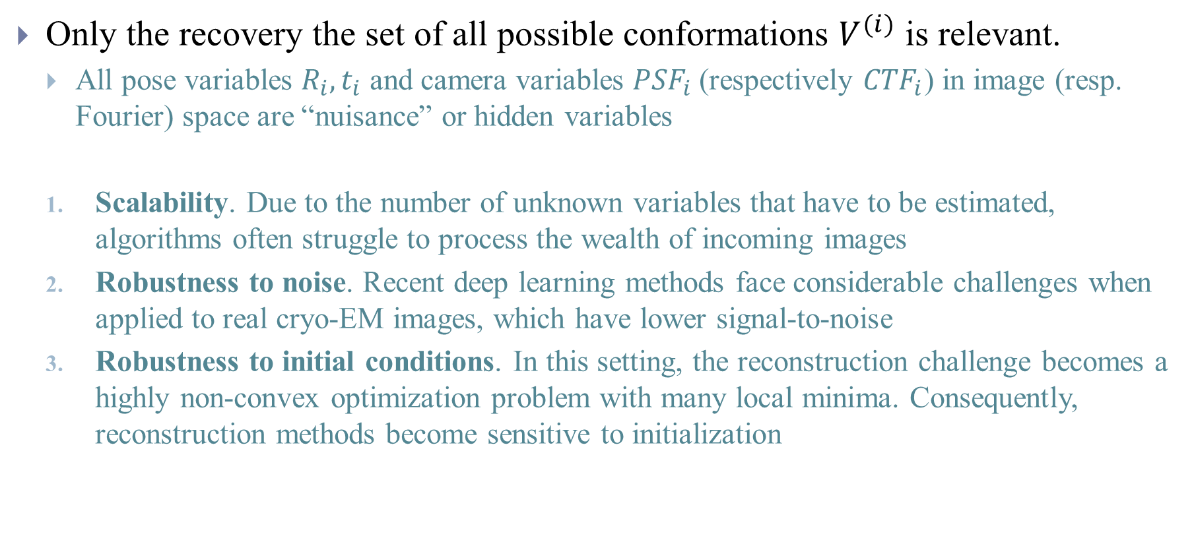
0. Challenges
Only the recovery the set of all possible conformations $V^{(i)}$ is relevant.
All pose variables $R_{i},t_{i}$ and camera variables ${PSF}_{i}$ (respectively ${CTF}_{i}$) in image (resp. Fourier) space are “nuisance” or hidden variables
Scalability. Due to the number of unknown variables that have to be estimated, algorithms often struggle to process the wealth of incoming images
Robustness to noise. Recent deep learning methods face considerable challenges when applied to real cryo-EM images, which have lower signal-to-noise
Robustness to initial conditions. In this setting, the reconstruction challenge becomes a highly non-convex optimization problem with many local minima. Consequently, reconstruction methods become sensitive to initialization
Notes:
As put by Singer et al.8, while they have the potential to impact the quality of the reconstruction by scrambling the signal, they do not bring any information of biological relevance
to the point where “the cost of image analysis can exceed 500,000 CPU hours on large, expensive computer clusters"10 for a single experiment.

Slide 6
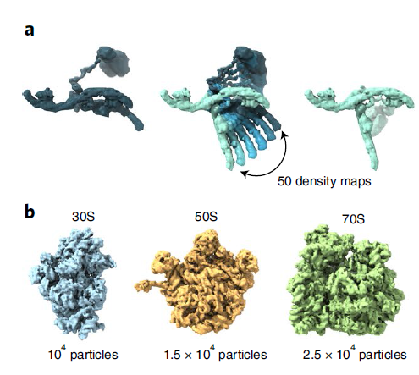
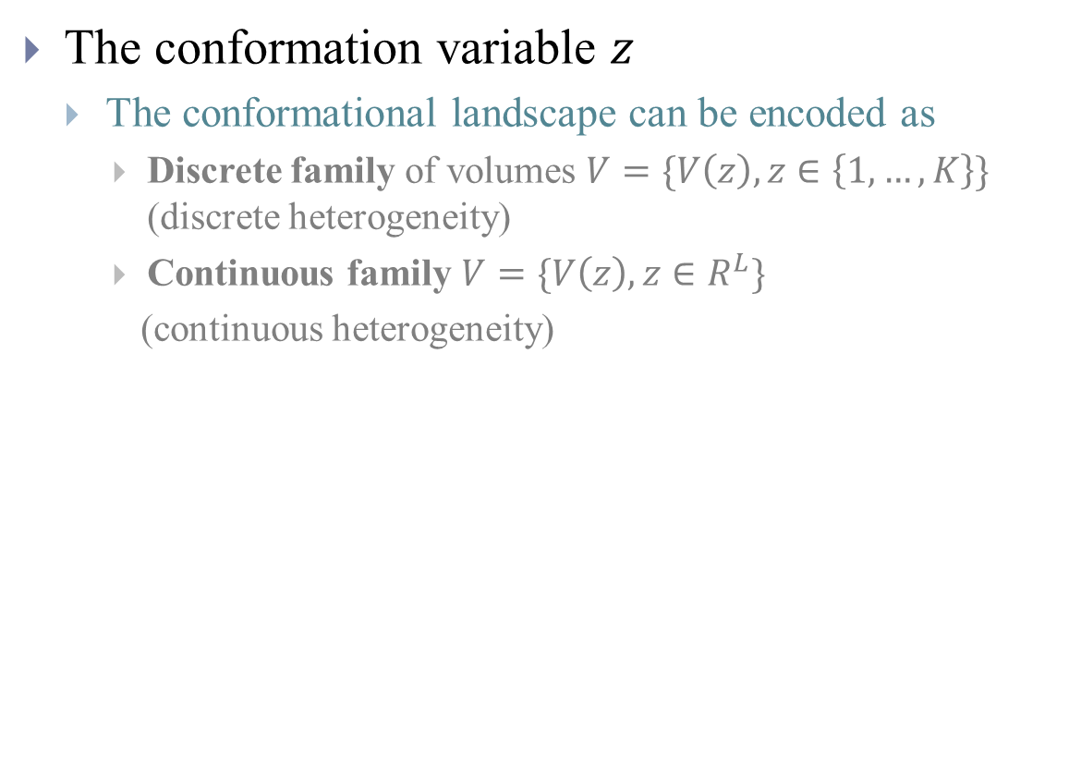
1. Generative modeling for cryo-EM
The conformation variable $z$
The conformational landscape can be encoded as
Discrete family of volumes $V=\{V\left(z\right), z∈\left\{1,…,K\right\}\}$ (discrete heterogeneity)
Continuous family $V=\{V\left(z\right), z∈R^{L}\}$
(continuous heterogeneity)
Notes:
In both cases, the family is parametrized by a variable z that encodes information about a molecule’s specific conformation. We use the notations Vz and V(z) interchangeably. Note that homogeneous reconstruction can be taken as a special case of this parametrization, in which case V only comprises a single volume, and K = 1 or L = 0. We can now write V(i) =V(zi) in Equation (1) and ˜V (i) = ˜V (zi)

Slide 7
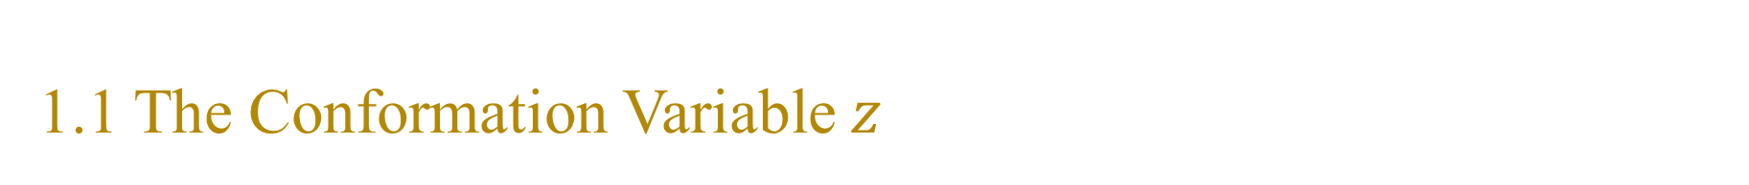
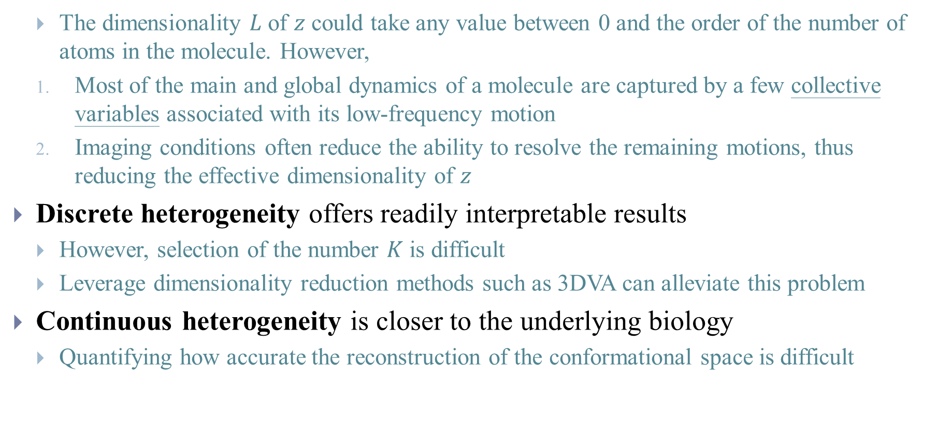
1.1 The Conformation Variable $z$
The dimensionality $L$ of $z$ could take any value between 0 and the order of the number of atoms in the molecule. However,
Most of the main and global dynamics of a molecule are captured by a few collective variables associated with its low-frequency motion
Imaging conditions often reduce the ability to resolve the remaining motions, thus reducing the effective dimensionality of $z$
Discrete heterogeneity offers readily interpretable results
However, selection of the number $K$ is difficult
Leverage dimensionality reduction methods such as 3DVA can alleviate this problem
Continuous heterogeneity is closer to the underlying biology
Quantifying how accurate the reconstruction of the conformational space is difficult
Notes:
a set of 3D volumes, representing the centroids of K main clusters of conformations

Slide 8
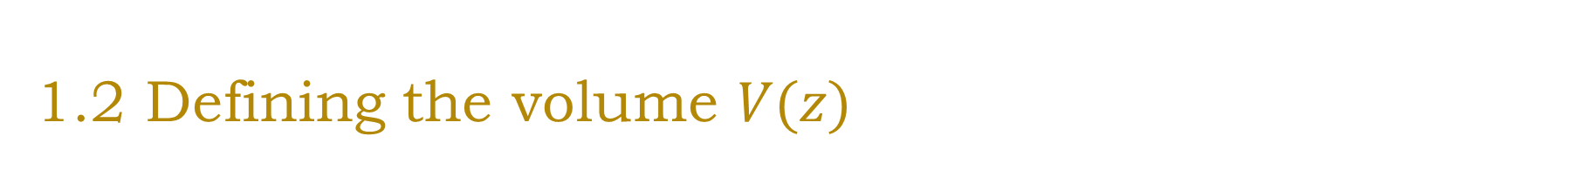
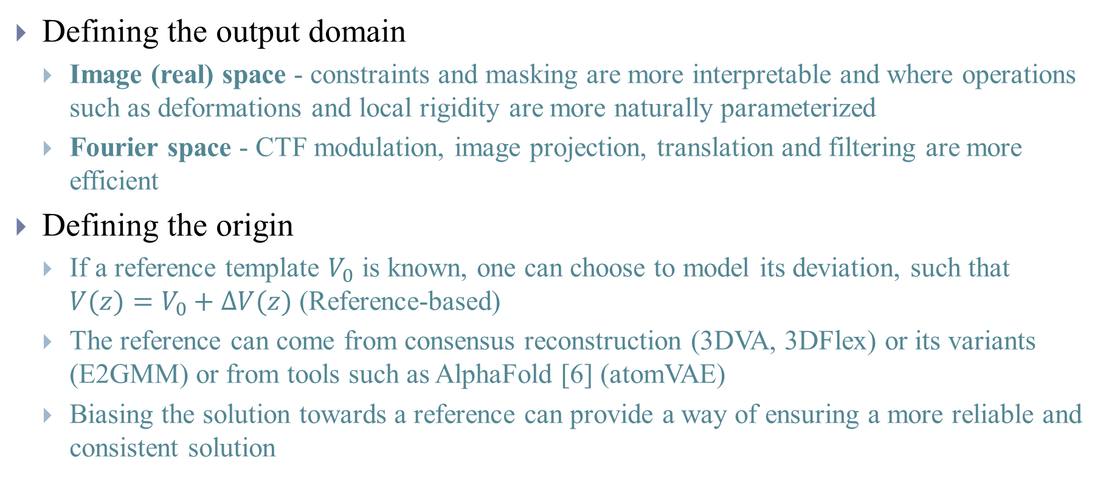
1.2 Defining the volume $V(z)$
Defining the output domain
Image (real) space - constraints and masking are more interpretable and where operations such as deformations and local rigidity are more naturally parameterized
Fourier space - CTF modulation, image projection, translation and filtering are more efficient
Defining the origin
If a reference template $V_{0}$ is known, one can choose to model its deviation, such that $V(z)=V_{0}+∆V(z)$ (Reference-based)
The reference can come from consensus reconstruction (3DVA, 3DFlex) or its variants (E2GMM) or from tools such as AlphaFold [6] (atomVAE)
Biasing the solution towards a reference can provide a way of ensuring a more reliable and consistent solution
Notes:
each volume within the family of possible conformations V can be described either in terms of its image pixel intensities or its Fourier coefficients
takes its values either in R, where values represent image pixel intensities, or in C, where values represent the amplitude and phase of the Fourier coefficients.
This approach has the advantage of naturally biasing the representation of V such that DV(z) = 0 implies V(z) =V0, which in turn, can yield better conformations given the complexity of the problem.
Rosenbaum et al (atomVAE) for instance report that adopting a reference-template and warm-starting their algorithm is essential to ensure the recovery of good conformations. However, there is a strong push in the community for
methods able to operate in a reference-free setting

Slide 9
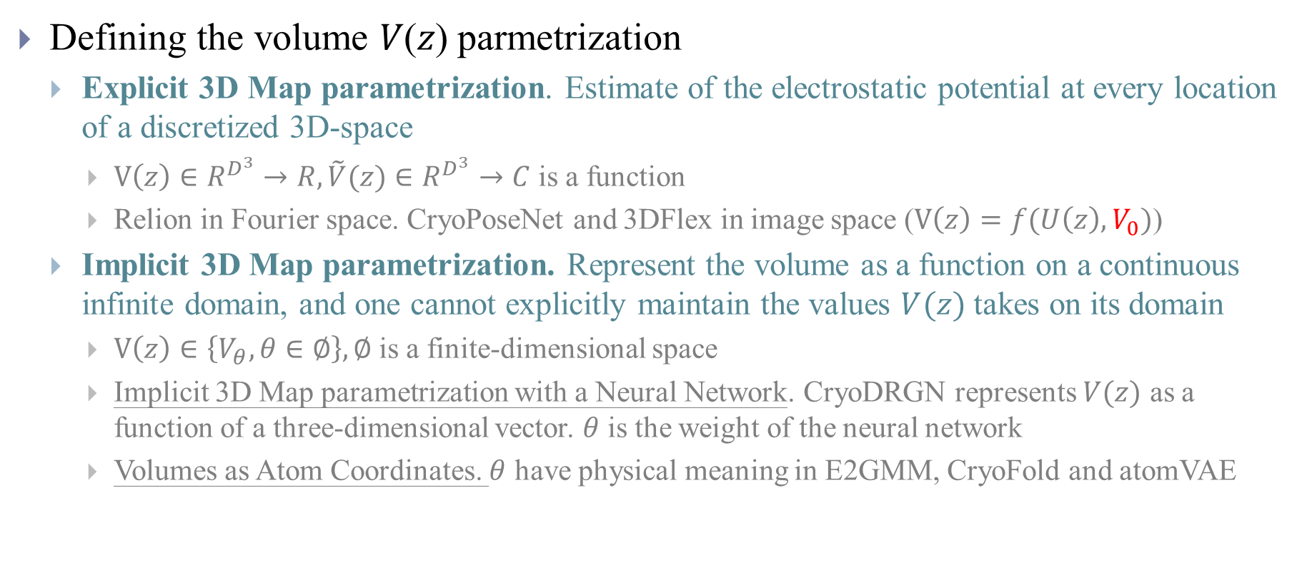
1.2 Defining the volume $V(z)$
Defining the volume 𝑉(𝑧) parmetrization
Explicit 3D Map parametrization. Estimate of the electrostatic potential at every location of a discretized 3D-space
$V\left(z\right)∈R^{D^{3}}→R, \tilde{V}(z)∈R^{D^{3}}→C$ is a function
Relion in Fourier space. CryoPoseNet and 3DFlex in image space ($V\left(z\right)=f(U\left(z\right),V_{0})$)
Implicit 3D Map parametrization. Represent the volume as a function on a continuous infinite domain, and one cannot explicitly maintain the values $V(z)$ takes on its domain
$V\left(z\right)∈\left\{V_{θ},θ∈∅\right\},∅$ is a finite-dimensional space
Implicit 3D Map parametrization with a Neural Network. CryoDRGN represents $V(z)$ as a function of a three-dimensional vector. $θ$ is the weight of the neural network
Volumes as Atom Coordinates. $θ$ have physical meaning in E2GMM, CryoFold and atomVAE
Notes:
where f is a convection operator used to deform the volume V0 based on U, and z is the conformation variable. The deformation flow U is parametrized through a neural network.
Depending on whether these parameters have a physical meaning (e.g. centroids of pseudo-atoms) or not, we distinguish two types of parametrization
where x 2 R3 represents a 3D coordinate in real Image space, and cj 2 R3 are the 3D coordinates of the N individual atoms or pseudo-atoms. The parameters Aj 2 R and s2j 2 R describe how each (pseudo-)atom contributes to the electrostatic potential
Compared to reference-free approaches, this unlocks new doors for molecular reconstruction by allowing parametrizations that are more amenable to taking into account molecular physics and dynamics. Interestingly, the authors of atomVAE found that using a reference-based method with respect to some base conformation was critical: randomly initialising the atomic coordinates did not yield useful structures. However, relying on a reference could also induce larger biases.

Slide 10
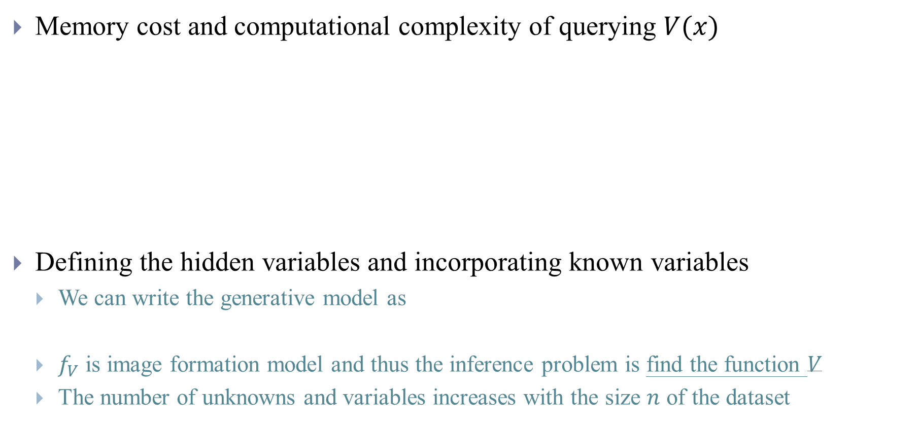
1.3 Complexity and Implementation
Memory cost and computational complexity of querying $V(x)$
Defining the hidden variables and incorporating known variables
We can write the generative model as
$f_{V}$ is image formation model and thus the inference problem is find the function $V$
The number of unknowns and variables increases with the size $n$ of the dataset
Notes:
theta in Rp the parameters associated with the function V, that takes as input the conformation variable and domain coordinates. Thus, from a statistical viewpoint, the observed images Xi are generated through a function
fV of image-specific variables Hi = (PSFi;si; ti;Ri; zi) and shared parameters theta
In reality, it is very difficult to recover all variables in Hi at once. Cryo-EM reconstruction methods vary according to the amount of information that is assumed known, i.e. which latent covariates in Hi are assumed to be given (which implies that they must be computed beforehand via an external algorithm), and which will need to be imputed during reconstruction.
In fact, almost all the approaches presented in this review assume that the CTF (or PSF) has been estimated and is known; it is indeed possible to estimate the CTF independently from reconstructing the volume. The methods presented in this review subsequently differ in the latent variables that are effectively imputed: as shown in Table 1, some methods assume that the translation ti is known and focus on the problem of estimating specific conformation variable zi with associated V(zi), or vice versa. Section 2 will further explain Table 1 and present the inference methods that are used to impute the different latent variables in each approach

Slide 11
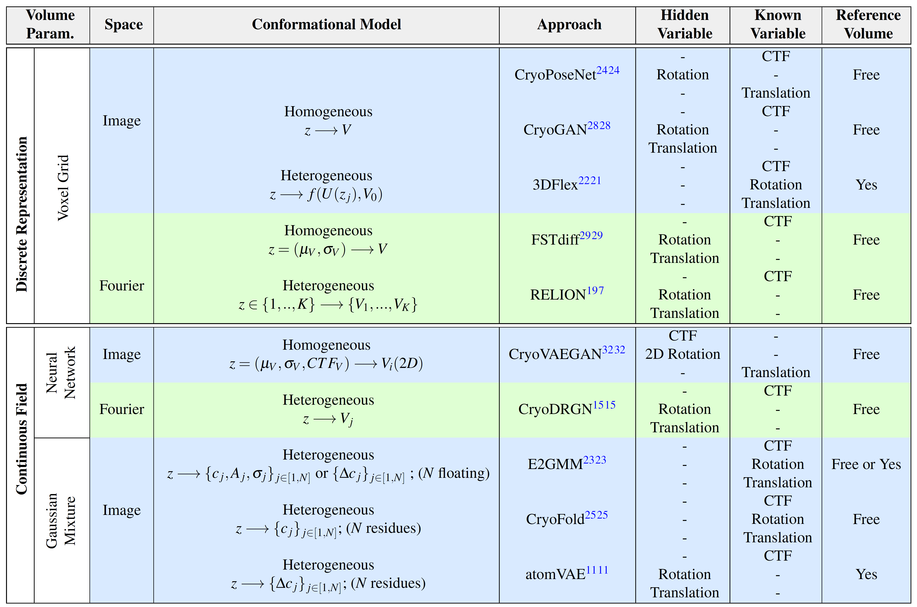

Slide 12
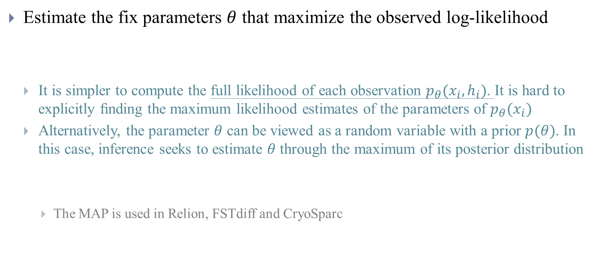
2. Inference
Estimate the fix parameters $θ$ that maximize the observed log-likelihood
It is simpler to compute the full likelihood of each observation $p_{θ}(x_{i},h_{i})$. It is hard to explicitly ﬁnding the maximum likelihood estimates of the parameters of $p_{θ}(x_{i})$
Alternatively, the parameter $θ$ can be viewed as a random variable with a prior $p(θ)$. In this case, inference seeks to estimate $θ$ through the maximum of its posterior distribution
The MAP is used in Relion, FSTdiff and CryoSparc
Notes:
These maximum-likelihood (ML) approaches view the parameter q as an unknown real value (as opposed to a random variable)
We observe that the ML and MAP objectives in Equations (5)-(6) only differ through the prior term log p(theta), while the challenge of the optimization stems froms the intractable term L(X;theta)
Both approaches traditionally employ the same optimization techniques. In what follows, we thus describe these techniques by focusing solely on the term L(X;theta)

Slide 13
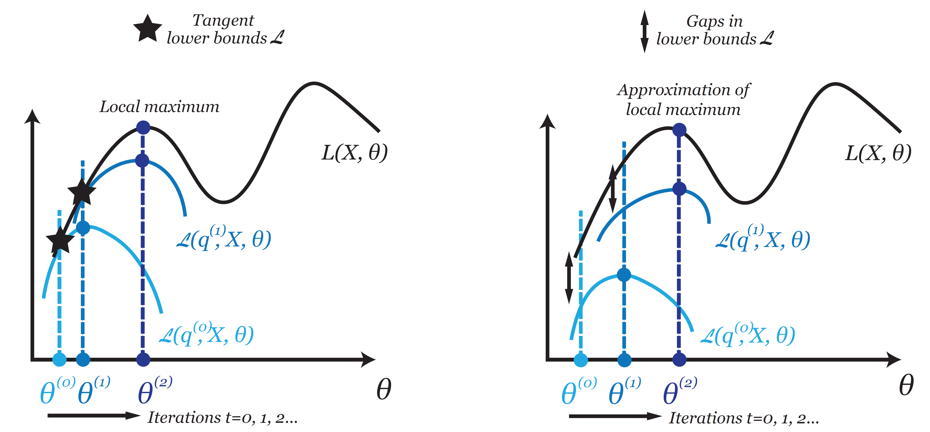
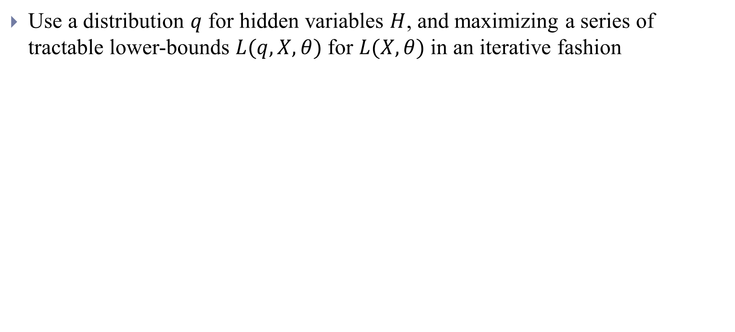
2. Evidence Lower Bound (ELBO)
Use a distribution $q$ for hidden variables $H$, and maximizing a series of tractable lower-bounds $L(q,X,θ)$ for $L(X,θ)$ in an iterative fashion
Notes:
The cryo-EM reconstruction inference methods typically maximize the log-likelihood through the maximization of some Evidence Lower Bound (ELBO).
The full likelihood L(X;H;q) would be easier to optimize with respect to q, as its definition does not involve an integral, but it depends on hidden variables H which are inaccessible
By iteratively maximizing these lower bounds with respect to q, the true likelihood L(X;theta) also increases. The hope is that the value of q obtained through their maximization will be close to the value realizing the maximum of L(X;theta), if the lower bounds are tight enough

Slide 14
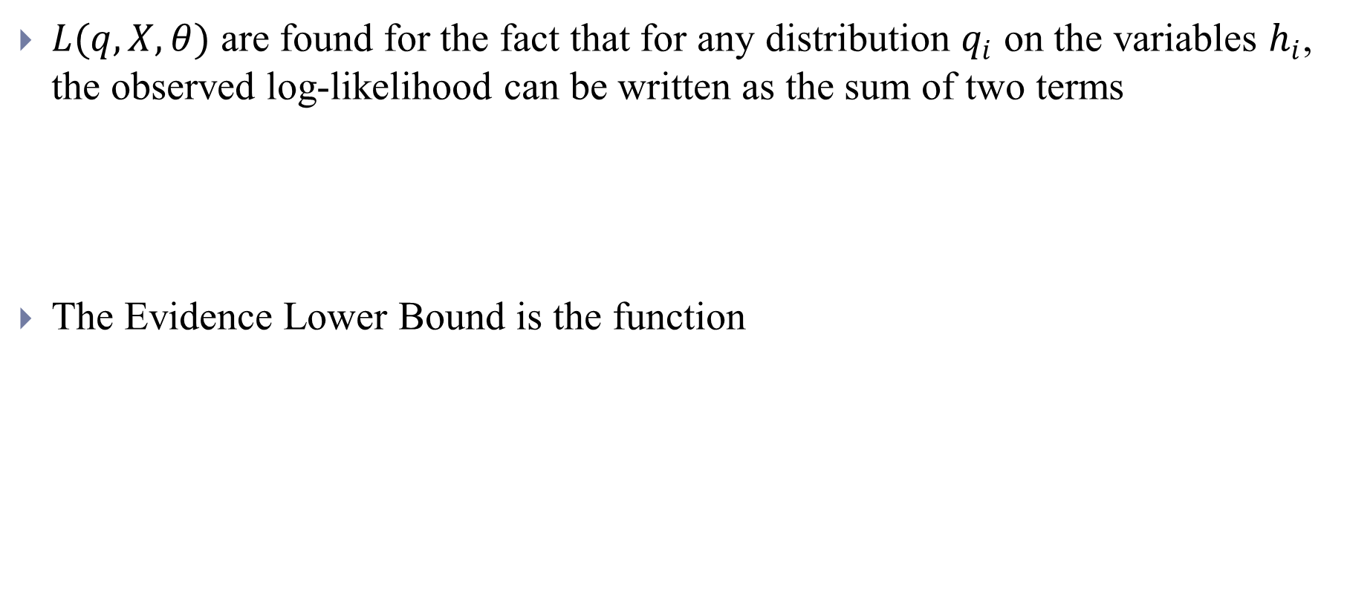
2. Evidence Lower Bound (ELBO)
$L(q,X,θ)$ are found for the fact that for any distribution $q_{i}$ on the variables $h_{i}$, the observed log-likelihood can be written as the sum of two terms
The Evidence Lower Bound is the function
Notes:
Refining the distributions q(t) i at each iteration t until convergence of the theta(t) provides a series of computable lower bounds to the log-likelihood that, in turn, allows to estimate theta.

Slide 15
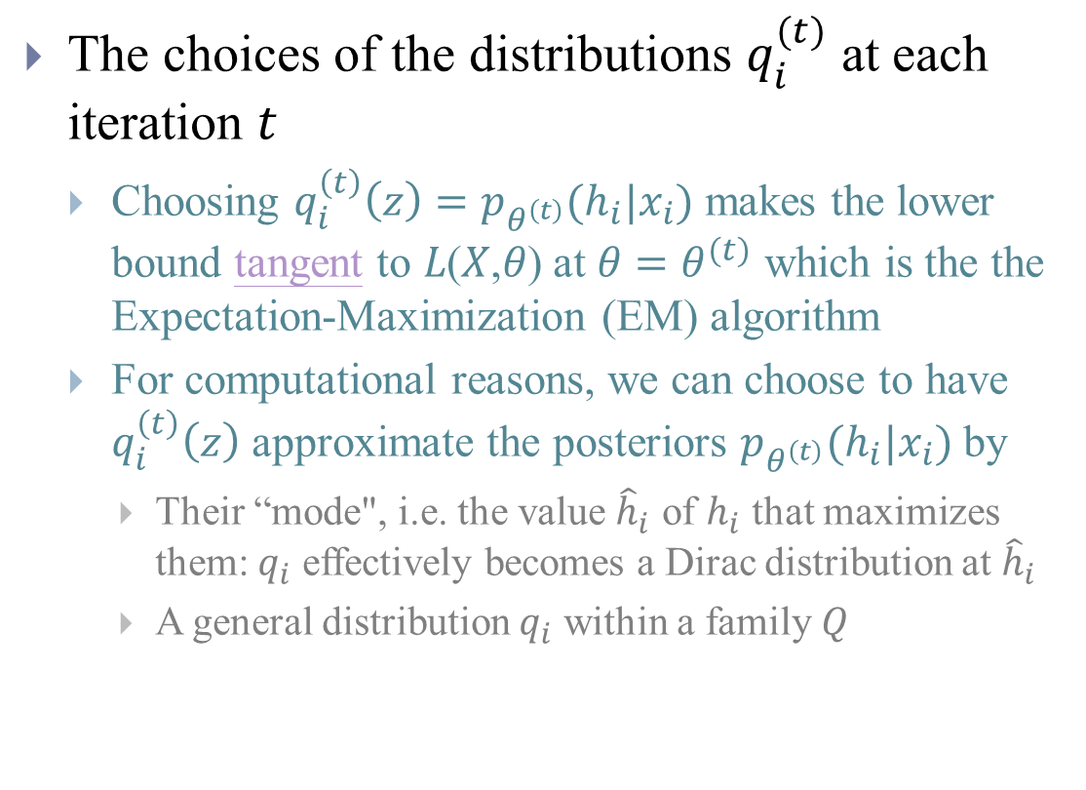
2. Inference Methods Based on an ELBO
The choices of the distributions $q_{i}^{(t)}$ at each iteration $t$
Choosing $q_{i}^{\left(t\right)}\left(z\right)=p_{θ^{\left(t\right)}}(h_{i}|x_{i})$ makes the lower bound tangent to 𝐿(𝑋,𝜃) at $θ=θ^{(t)}$ which is the the Expectation-Maximization (EM) algorithm
For computational reasons, we can choose to have $q_{i}^{\left(t\right)}\left(z\right)$ approximate the posteriors $p_{θ^{\left(t\right)}}(h_{i}|x_{i})$ by
Their “mode", i.e. the value ${\hat{h}}_{i}$ of $h_{i}$ that maximizes them: $q_{i}$ effectively becomes a Dirac distribution at ${\hat{h}}_{i}$
A general distribution $q_{i}$ within a family $Q$

Slide 16
2.1 Expectation-maximization (EM) Algorithm
EM as a Dual Ascent Algorithm (Use in Relion and CryoSparc)
The bottleneck is
Notes:
https://eml.berkeley.edu/~train/Ch14EM.pdf
The computation of the posterior could be achieved by using a closed form for the expression of the probability p(hijxi;q(t􀀀1)) and maximizing over its parameters. In cryo-EM generative models, however, such a closed form is not known.
Alternatively, one can evaluate pq(t􀀀1) (hijxi) for each hi discretized on a grid by computing the integral in Equation (11) via a Riemann sum as in RELION or via Importance Sampling as in CryoSPARC. RELION and
CryoSPARC use the EM algorithm with MAP estimation of q, as opposed to ML estimation. Additionally, CryoSPARC uses stochastic gradient descent for the maximizations in the M-step, at each iteration t.

Slide 17
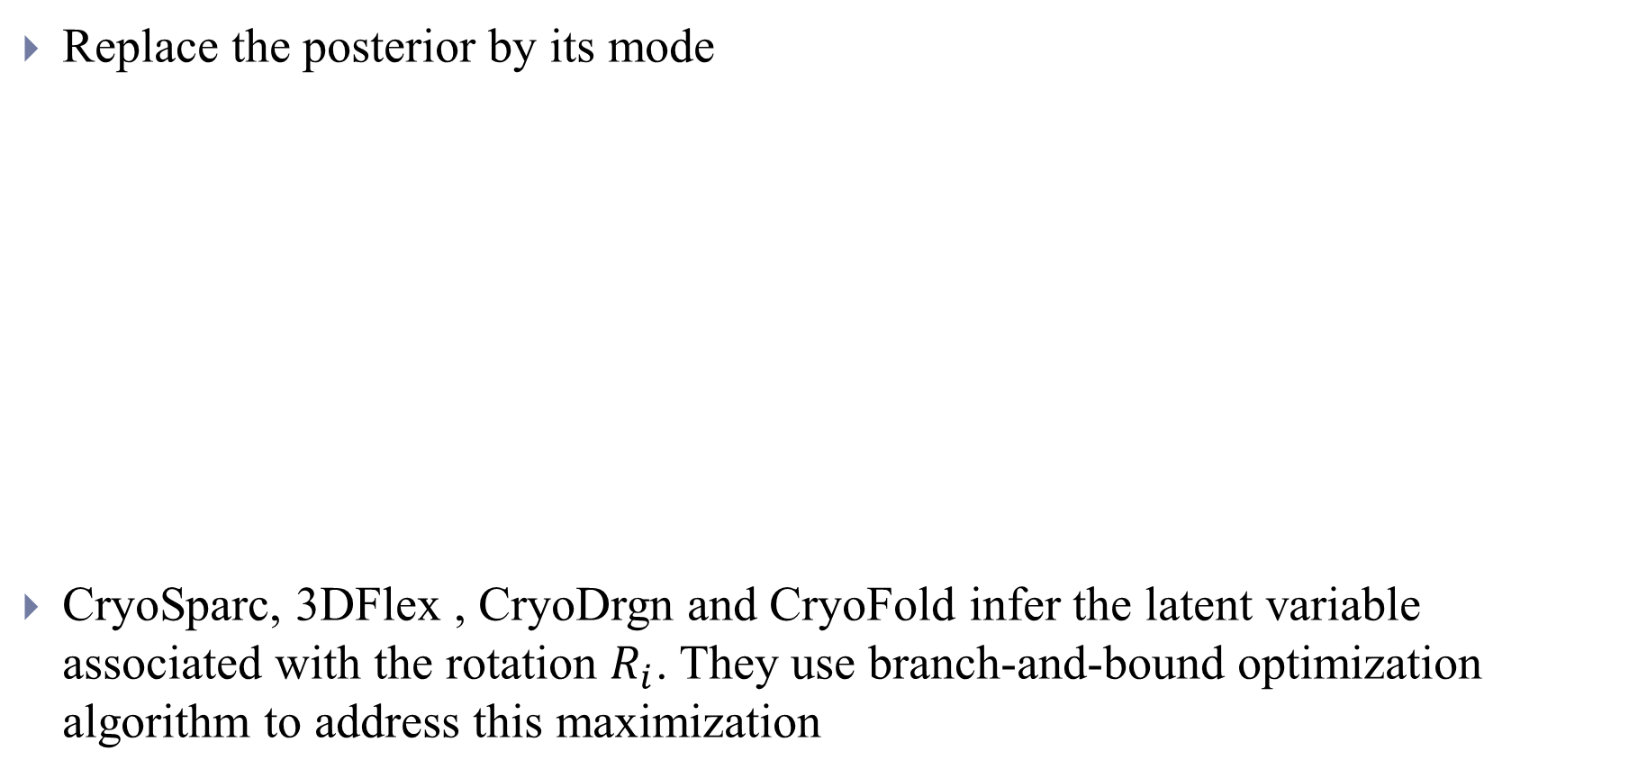
2.2 Modal EM algorithm
Replace the posterior by its mode
CryoSparc, 3DFlex , CryoDrgn and CryoFold infer the latent variable associated with the rotation $R_{i}$. They use branch-and-bound optimization algorithm to address this maximization
Notes:
the most probable ˆhi for each image xi.
Do not need to calculate the intergral

Slide 18
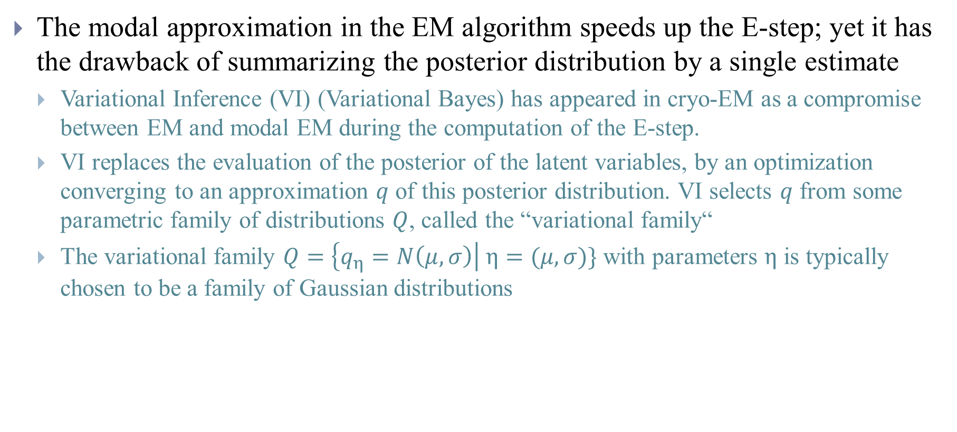
2.3 Variational EM algorithm
The modal approximation in the EM algorithm speeds up the E-step; yet it has the drawback of summarizing the posterior distribution by a single estimate
Variational Inference (VI) (Variational Bayes) has appeared in cryo-EM as a compromise between EM and modal EM during the computation of the E-step.
VI replaces the evaluation of the posterior of the latent variables, by an optimization converging to an approximation $q$ of this posterior distribution. VI selects $q$ from some parametric family of distributions $Q$, called the “variational family“
The variational family $Q=\left\{q_{η}=N\left(μ,σ\right)\right| η=(μ,σ)\}$ with parameters $η$ is typically chosen to be a family of Gaussian distributions
Notes:
reducing accuracy and leading to non-tangent lower bounds
such that q is the "closest" to the posterior, where “closest" is defined in terms of the KL divergence
Other approaches consider the variational family of Gaussian distributions with fixed isotropic variance s0, i.e. Q = fqh = N(h;s0)jhg. In modal EM, the parametric family can be seen as a family of Dirac distributions

Slide 19
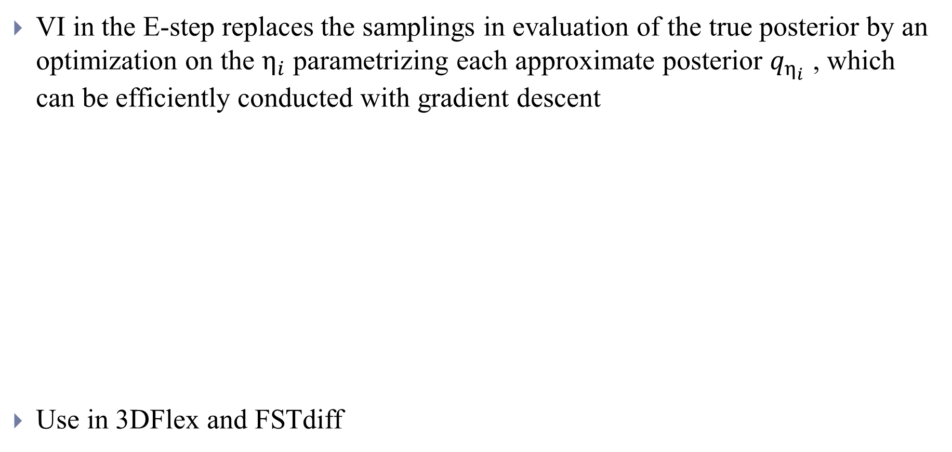
2.3 Variational EM algorithm
VI in the E-step replaces the samplings in evaluation of the true posterior by an optimization on the $η_{i}$ parametrizing each approximate posterior $q_{η_{i}}$ , which can be efficiently conducted with gradient descent
Use in 3DFlex and FSTdiff
Notes:
Variational gradient EM is used in 3DFlex22 to infer the rotation variable Ri, using the variational family of Gaussian distributions with fixed isotropic variance s0.
Variational EM is also used in FSTdiff in the context of homogeneous reconstruction. Here, VI happens both in Step (a), to estimate the approximate posterior of the rotation Ri, and in Step (b) to also estimate the approximate posterior of the volume V, which is a parameter included in q. The approximate posterior of V provides an approximate measure of uncertainty on the homogeneous reconstruction

Slide 20
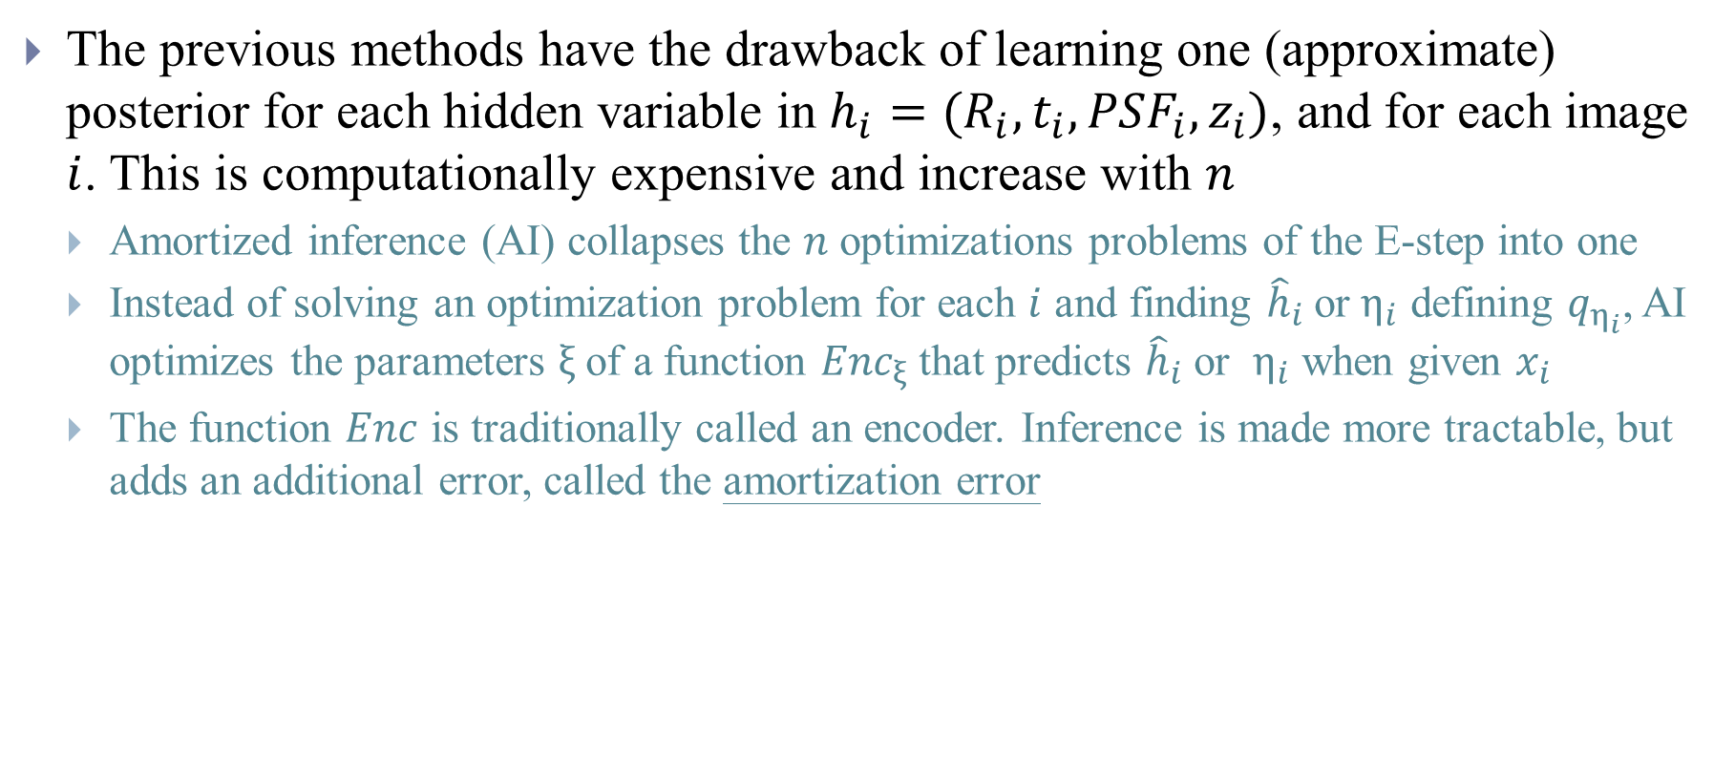
2.4 Introducing Amortized Inference
The previous methods have the drawback of learning one (approximate) posterior for each hidden variable in $h_{i}=(R_{i},t_{i},{PSF}_{i},z_{i})$, and for each image $i$. This is computationally expensive and increase with $n$
Amortized inference (AI) collapses the $n$ optimizations problems of the E-step into one
Instead of solving an optimization problem for each $i$ and finding ${\hat{h}}_{i}$or $η_{i}$ defining $q_{η_{i}}$, AI optimizes the parameters $ξ$ of a function ${Enc}_{ξ}$ that predicts ${\hat{h}}_{i}$ or $η_{i}$ when given $x_{i}$
The function $Enc$ is traditionally called an encoder. Inference is made more tractable, but adds an additional error, called the amortization error

Slide 21
2.4 Introducing Amortized Inference
The main realizations of amortized variational gradient EM in cryo-EM come through variational autoencoders

Slide 22
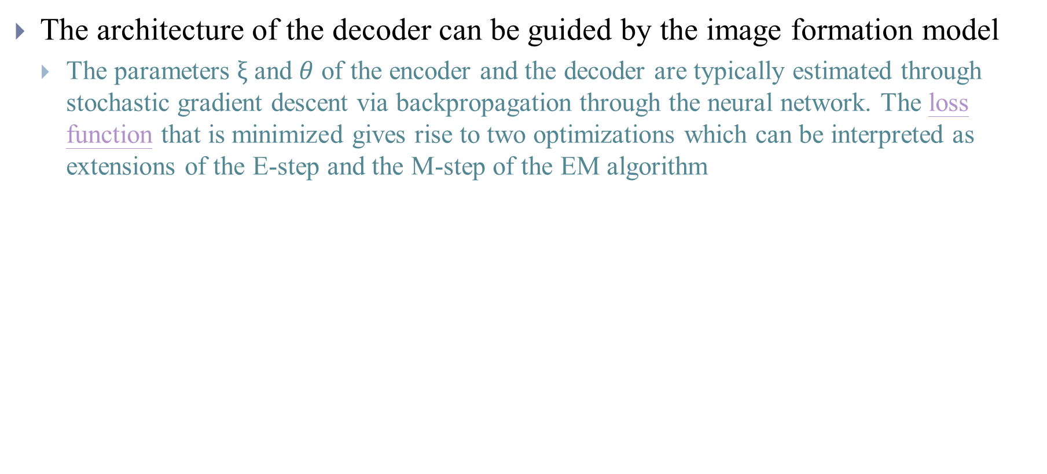
2.4 Introducing Amortized Inference
The architecture of the decoder can be guided by the image formation model
The parameters $ξ$ and $θ$ of the encoder and the decoder are typically estimated through stochastic gradient descent via backpropagation through the neural network. The loss function that is minimized gives rise to two optimizations which can be interpreted as extensions of the E-step and the M-step of the EM algorithm
Notes:
For EM and variational EM algorithms, the optimizations (a)-(b) can be conducted fully at each iteration, or only a gradient step can be performed

Slide 23
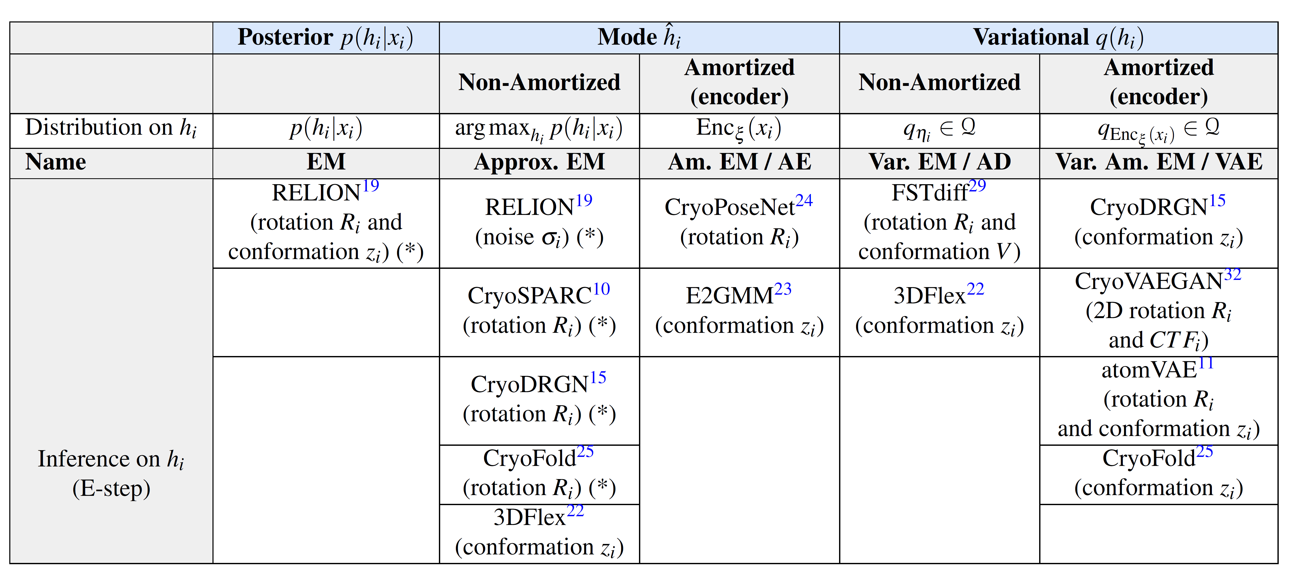
Notes:
We also note that, due to the volume of the data in cryo-EM, exact Bayesian inference procedures — such as Gibbs sampling or Hamiltonian Monte Carlo —cannot be easily deployed because of computational constraints. Cryo-EM reconstruction methods thus have to use the scalable inference schemes described in this review, that possibly approximate in the sense that they often approximate the true posterior of the hidden variables by another distribution q.

Slide 24
3. Discussion
Toolbox for quantitative assessment of reconstruction performances
Assessing spatial resolution of discretized reconstructions
Root Mean Square Deviation (RMSD) of atoms when volume can be represented as atomic coordinates
Evaluating conformation heterogeneity – Evaluate the embedding (energy landscape) or the trajectory and movies
Comparing performance: lack of common benchmarks
Lack of common datasets or cryo-EM simulators
Lack of unified metrics — How to evaluate the accuracy of the parameters?
Lack of reference code-bases — Implementing from scratch is tedious

Slide 25
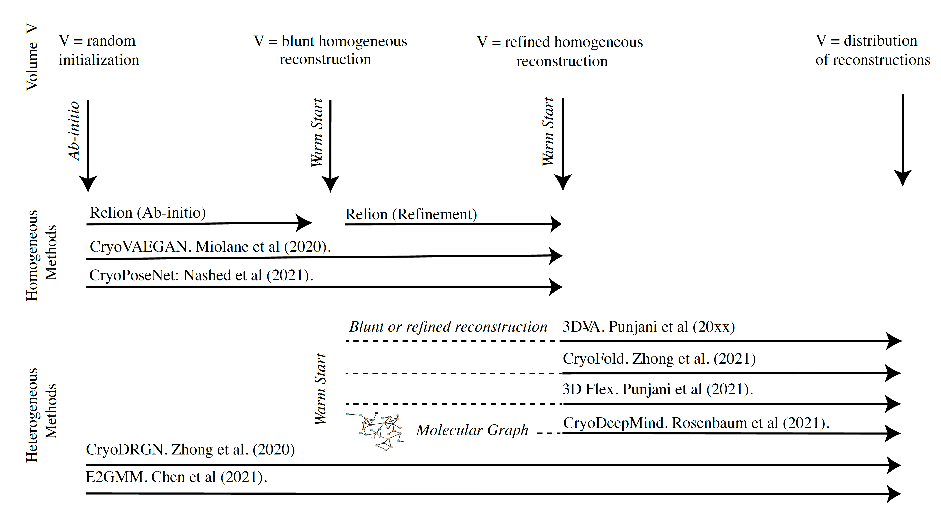
3. Discussion
Reproducibility and reliability in Cryo-EM
Tractability
Notes:
The non-convex nature of the problem puts it at very high-risk of being non robust and sensitive to initialization — this is a phenomenon sometimes referred to as “Einstein from noise” : the model is too heavily biased towards a reference template, and the optimization scheme fails to find the true signal in the data — “hallucinating” instead a solution close to the initialization point.
Furthermore, the inference methods presented often make use of additional implementation tricks (e.g. warm-starting with a known shape), and specific regularization schemes (described in Appendix 4.2-4.4). The importance of implementation tricks and regularizations, and combinations thereof, is still ill-understood and would require an in-depth analysis. For instance, atomVAE reports that warm-starting their algorithm is essential in ensuring the success of the volume recovery: they suggest starting with initial phase of pose-only training, which, once realised, ensures that the further joint learning of poses and volume is successful.
This hints towards a difficult optimization landscape for this method, and its great sensitivity o to initial conditions. Moreover, each inference method (from Section 2) uses a different parameterization of the volume (from Section 1). It is thus challenging to disentangle the importance of each choice in the reconstruction pipeline.
As such, such sophisticated methods can further benefit from gains in efficiency (both from the computational side and in terms of memory requirements). The efficient updating of a model’s parameters can thus be considered as a current computational bottleneck and offers an interesting avenue for future research.

Slide 26
Conclusion
This review compared and contrasted existing methods through their parametrization of the volume, as well as through the optimization procedure chosen to infer parameters and hidden variables
While the use of amortized inference is crucial to make inference tractable in this high-data, high-dimensional setting, there seems to be much room for improvement and research on methods —as amortized inference can translate into resolution
Current methods rely on a set of choices and hyperparameters that raise a number of questions for the practitioner
Have I chosen my hyperparameters adequately?
Is this choice going to impact the accuracy of the recovery?
Is there any physical or biological meaning or interpretation in the distance between the latent space of conformation variables?
How does error on pose or CTF affect the rest of the volume recovery process?
Notes:
There seems to be a crucial need for more in-depth and systematic studies of these methods of (a) sensitivity to initialization and (b) robustness to error in the different components of the model

Slide 27
Reference
[1] Gupta, M., et al. (2021). CryoEM and AI reveal a structure of SARS-CoV-2 Nsp2, a multifunctional protein involved in key host processes. BioRxiv.
[2] Wrapp, D., et al. (2020). Cryo-EM structure of the 2019-nCoV spike in the prefusion conformation. Science 367, 1260-1263.
[3] Mannar, Dhiraj, et al. (2022). SARS-CoV-2 Omicron variant: Antibody evasion and cryo-EM structure of spike protein–ACE2 complex. Science: eabn7760.
[4] Donnat, Claire, et al. (2022). Deep Generative Modeling for Volume Reconstruction in Cryo-Electron Microscop. arXiv preprint arXiv:2201.02867.
[5] Liu, Xiao, et al. (2021). Self-supervised learning: Generative or contrastive. IEEE Transactions on Knowledge and Data Engineering
[6] Jumper, J., et al. (2021). Highly accurate protein structure prediction with AlphaFold. Nature, 1-11.

Slide 28
Appendix

Slide 29
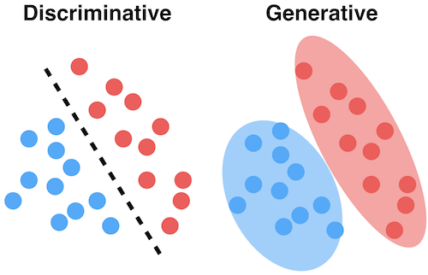
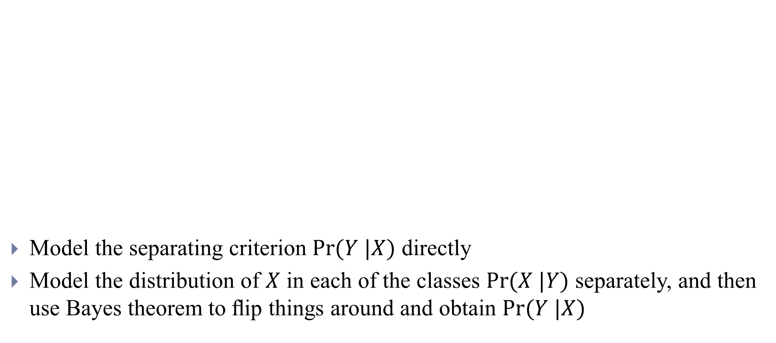
Generative and Discriminative Models for Classiﬁcation
Model the separating criterion $Pr⁡(Y |X)$ directly
Model the distribution of $X$ in each of the classes $Pr⁡(X |Y)$ separately, and then use Bayes theorem to ﬂip things around and obtain $Pr⁡(Y |X)$
https://www.analyticsvidhya.com/blog/2021/07/deep-understanding-of-discriminative-and-generative-models-in-machine-learning/
Notes:
When we use normal (Gaussian) distributions for each class, this leads to linear or quadratic discriminant analysis. However, this approach is quite general, and other distributions can be used as well. We will focus on normal distributions

Slide 30
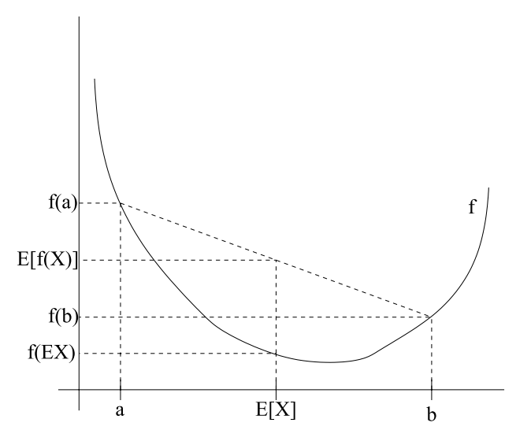
Expectation-Maximization
$$l\left(θ\right)=\sum_{i}{\log{p(x_{i};θ)}=\sum_{i}{\log{\sum_{z_{i}}{p({x_{i},z}_{i};θ)}}}}$$
$$=\sum_{i}{\log{\sum_{z_{i}}{Q_{i}(z_{i}) }}}\frac{p({x_{i},z}_{i};θ)}{Q_{i}(z_{i})}$$
$$≥\sum_{i}{\sum_{z_{i}}{Q_{i}(z_{i})\log{\frac{p({x_{i},z}_{i};θ)}{Q_{i}(z_{i})}} }}$$
$$\frac{p({x_{i},z}_{i};θ)}{Q_{i}(z_{i})}=c$$
$$Q_{i}\left(z_{i}\right)=\frac{p({x_{i},z}_{i};θ)}{\sum_{z}{p(x_{i},z;θ)}}=\frac{p({x_{i},z}_{i};θ)}{p(x_{i};θ)}=p(z_{i}|x_{i};θ)$$
$$f(E_{z_{i}\sim Q_{i}}[\frac{p\left({x_{i},z}_{i};θ\right)}{Q_{i}\left(z_{i}\right)}])≥E_{z_{i}\sim Q_{i}}[f(\frac{p\left({x_{i},z}_{i};θ\right)}{Q_{i}\left(z_{i}\right)})]$$
Notes:
$Q_{i}$ is some distribution

Slide 31
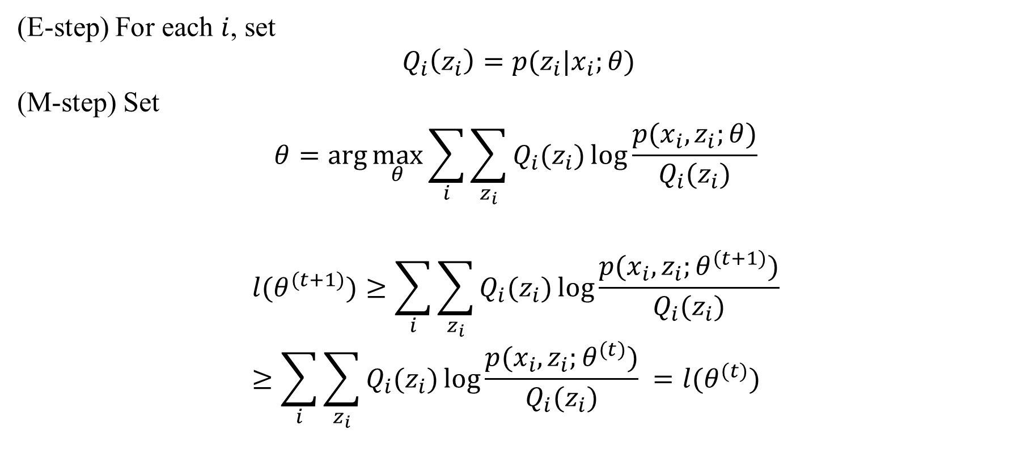
Expectation-Maximization
(E-step) For each $i$, set
$$Q_{i}\left(z_{i}\right)=p(z_{i}|x_{i};θ)$$
(M-step) Set
$$θ=arg\max_{θ}{\sum_{i}{\sum_{z_{i}}{Q_{i}(z_{i})\log{\frac{p({x_{i},z}_{i};θ)}{Q_{i}(z_{i})}} }}}$$
$$l(θ^{(t+1)})≥\sum_{i}{\sum_{z_{i}}{Q_{i}(z_{i})\log{\frac{p({x_{i},z}_{i};θ^{(t+1)})}{Q_{i}(z_{i})}} }}≥\sum_{i}{\sum_{z_{i}}{Q_{i}(z_{i})\log{\frac{p({x_{i},z}_{i};θ^{(t)})}{Q_{i}(z_{i})}} }=l(θ^{(t)})}$$

Slide 32
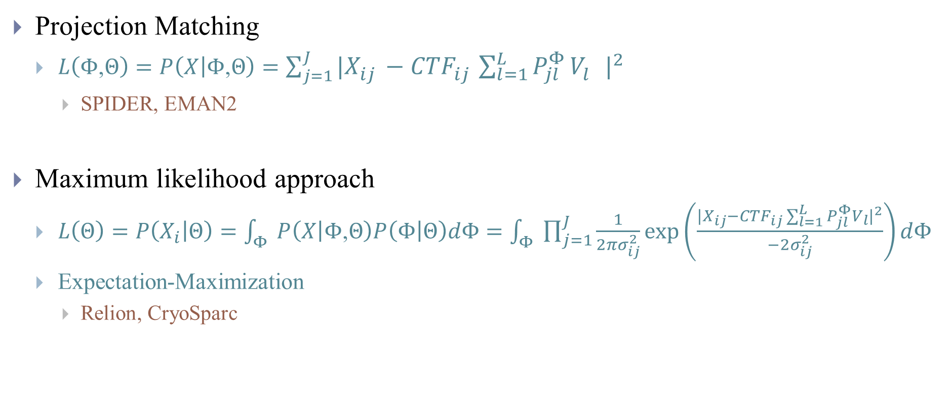
3D Refinement and Classification
Projection Matching
$L\left(Φ\text{,}Θ\right)=P\left(X | Φ\text{,}Θ\right)=\sum_{j=1}^{J}{{|X_{ij}^{}−{CTF}_{ij}^{}\sum_{l=1}^{L}{P_{jl}^{Φ}}V_{l}^{}|}^{2}}$
SPIDER, EMAN2
Maximum likelihood approach
$L\left(Θ\right)=P\left(X_{i} | Θ\right)=\int_{Φ}{P\left(X | Φ\text{,}Θ\right)P\left(Φ | Θ\right)dΦ}=\int_{Φ}{\prod_{j=1}^{J}{\frac{1}{2πσ_{ij}^{2}}\exp\left(\frac{|{X_{ij}−{CTF}_{ij}\sum_{l=1}^{L}{P_{jl}^{Φ}V_{l}}|}^{2}}{−2σ_{ij}^{2}}\right)dΦ}}$
Expectation-Maximization
Relion, CryoSparc
Model
Orientations
They are equivalent if there is no noise!
Notes:
When there is no noise weight of MLE is 1 only at the lowest MSE orientation which is exactly the same as projection matching

Slide 33
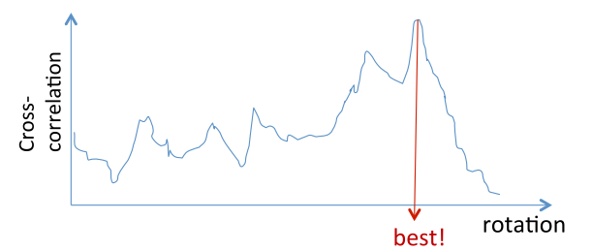
3D Refinement and Classification
Maximum likelihood results in weighted average structure

Slide 34
Variational inference
http://cpmarkchang.logdown.com/posts/737247-pgm-variational-inference (Render as SVG)
https://odie2630463.github.io/2018/09/20/vi-2/

Slide 35
2.5 Generative Adversarial Networks
The only hidden variable of interest is the conformation variable and associated molecular volumes. As a result, recent works have explored methods that avoid the inference on the “nuisance" latent variables altogether
Notes:
Even though a GAN iterates two steps, including one step related to the estimation of the model’s parameters, its framework differ from the variations of the EM algorithm in the sense that the hidden variables are not inferred: it is enough to be able to randomly sample from them from some prior distribution.

Slide 36
